Slide 1
QC Portal Update
By: Thomas W

Slide 2
Problem Statement
Entering results for General Operations and Seal Test tests into QC Portal is unnecessarily repetitive, leading to wasted time and inducing errors.

Slide 3
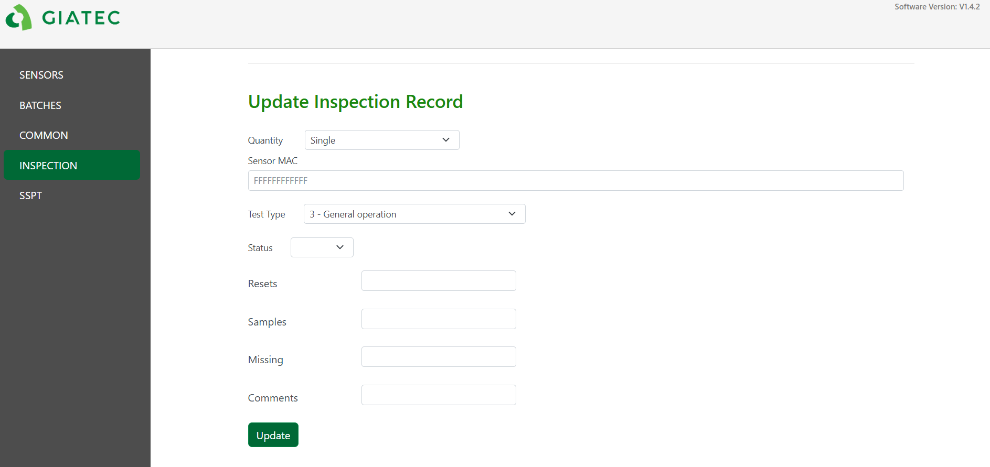
General Operations Old Layout
In the old layout, the QC team would update general operation records by fetching sensor voltage values from Grafana, then manually inserting them into the database one sensor at a time using single input mode, as seen in the image below. This process could be very time consuming and error inducing as it was often repeated for hundreds of sensors at a time.

Slide 4
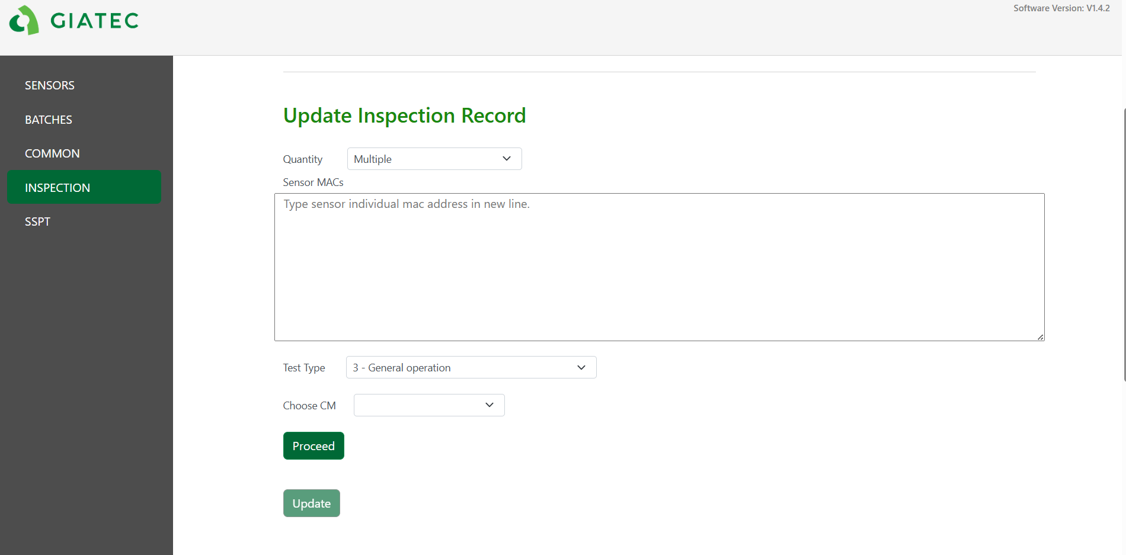
General Operations Updated layout
In the new layout, the General Operation records can be updated for multiple macs at once. This is done by inserting the macs, choosing the desired CM and clicking “Proceed”. Then, the program will automatically extract the voltage values and error statuses of each sensor (related to the specified CM) from the MFT database and present them in a table for the user to inspect. The user can then press “Update” to insert the data if they are satisfied with it. A more detailed user walkthrough can be seen in the flow chart below.

Slide 5
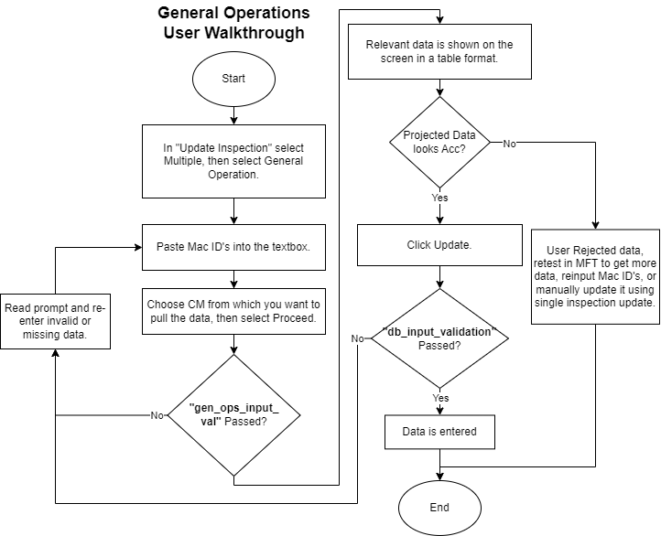
General Operations Walkthrough

Slide 6
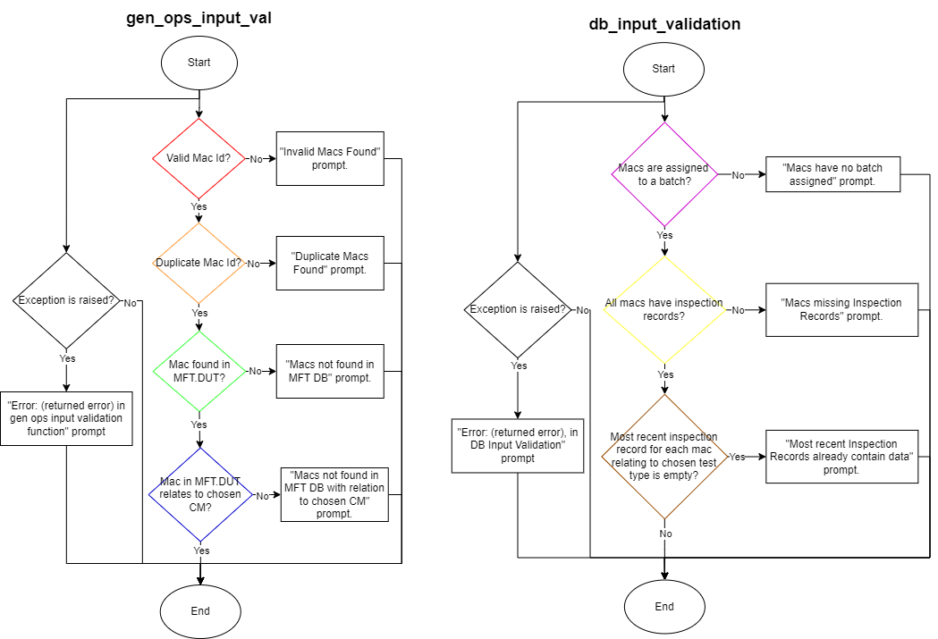
General Operations Walkthrough

Slide 7
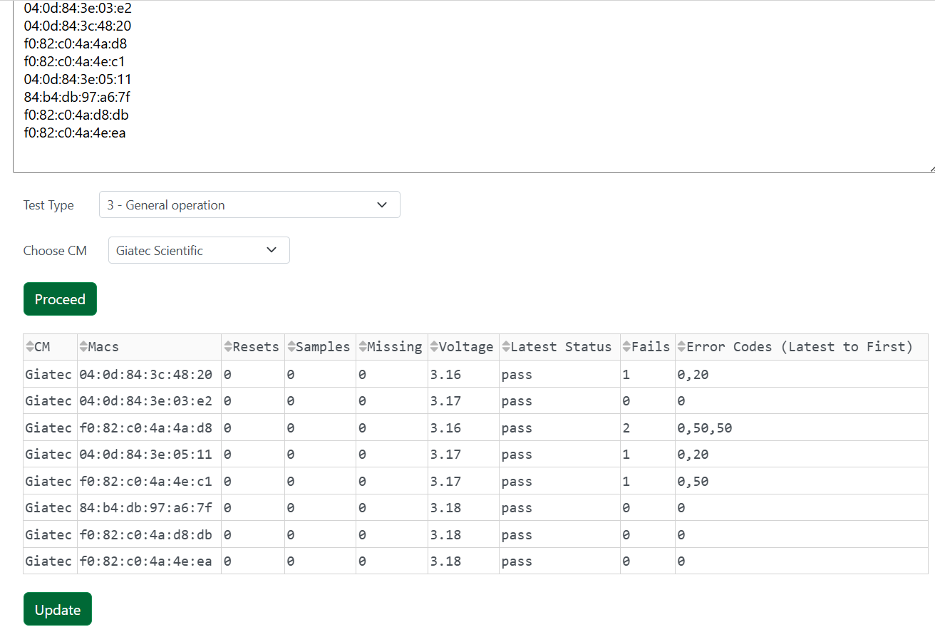
General Operations Walkthrough

Slide 8
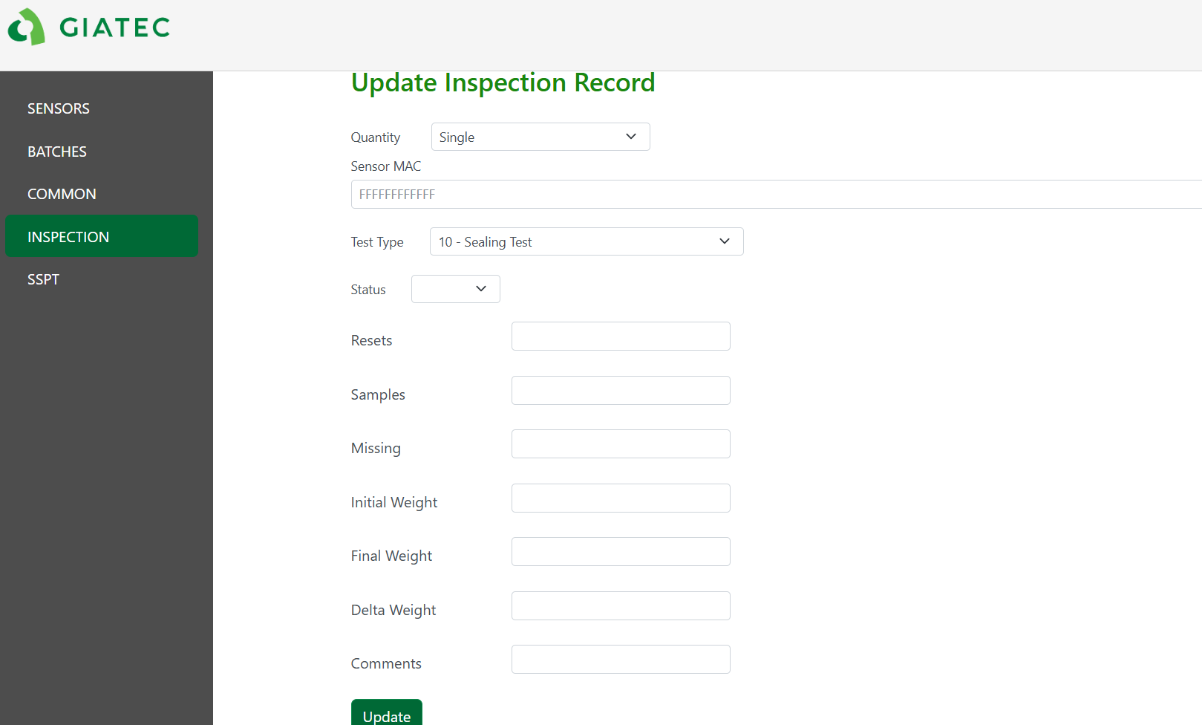
Seal Test Old Layout
In the old layout, the QC team would update seal test records by manually inserting the initial/final/delta weights of the sensors along with their resets, samples, and missing samples into the database one sensor at a time. This was usually done for 10 sensors at a time and could also be very time consuming and error inducing since the user would have to look through an excel file to find the samples of each sensor.

Slide 9
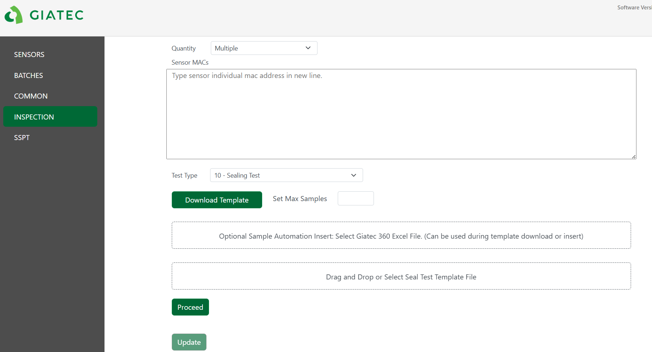
Seal Test Updated Layout
In the new layout, the records of all macs in a Seal Test can be updated at once. If the user doesn't have a saved template yet they will need to insert the macs of the sensors they wish to update and press "Download Template". This will create a template csv file containing the inserted macs and download it on the users computer. Then, the user will fill in the empty columns, and reupload it. They will then be presented with a table in which they can verify the data before inserting it in to the database.

Slide 10
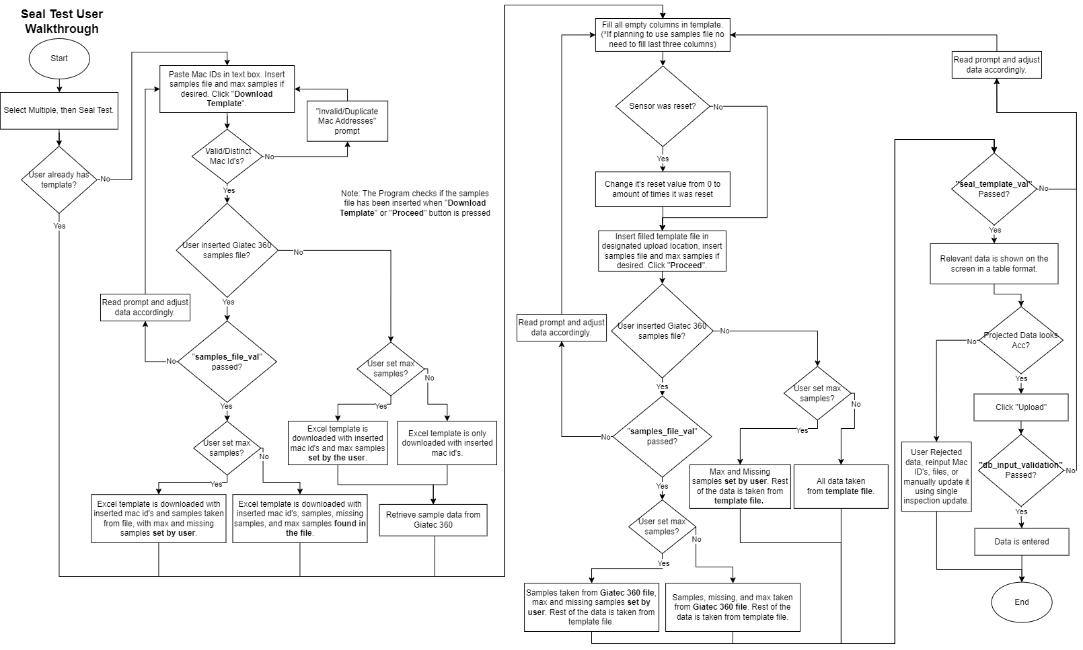
Seal Test Walkthrough

Slide 11
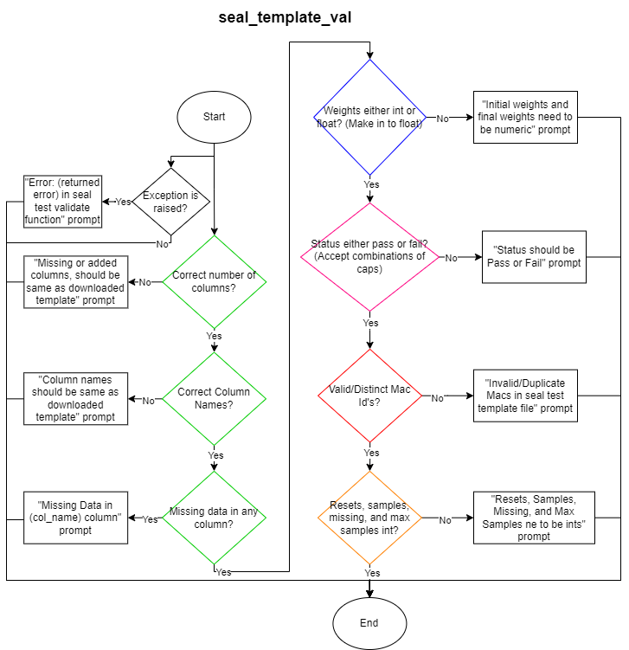
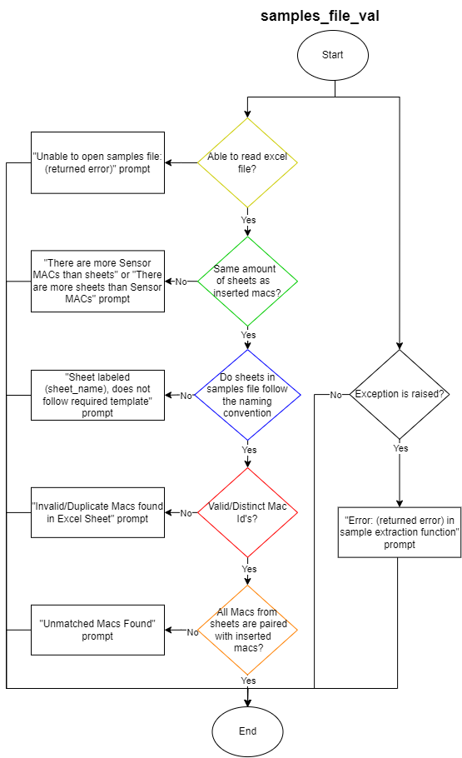
Seal Test Walkthrough

Slide 12
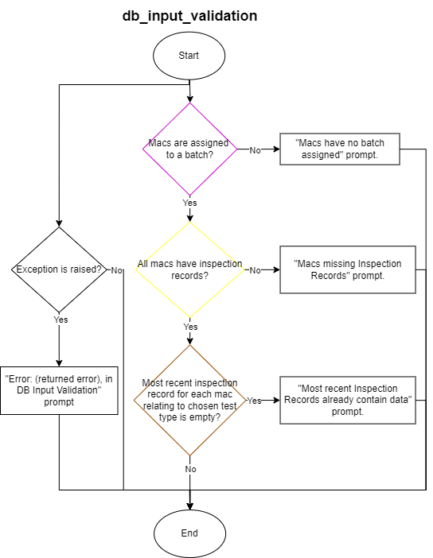
Seal Test Walkthrough

Slide 13
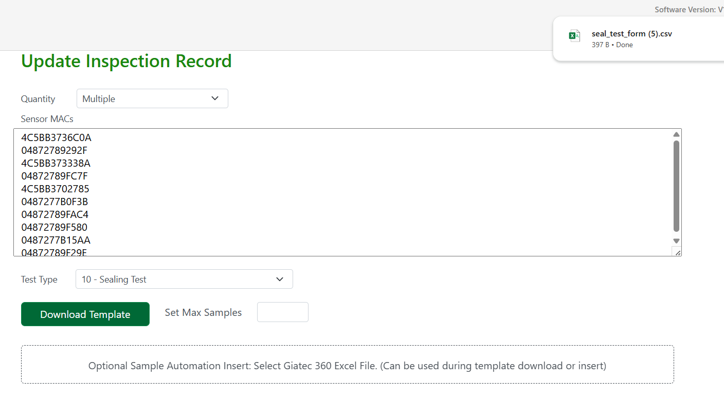
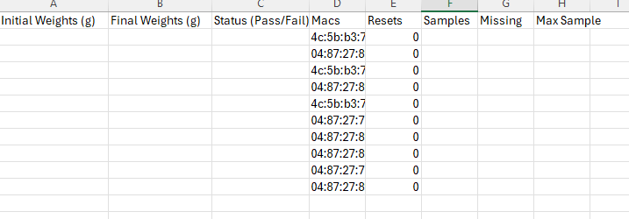
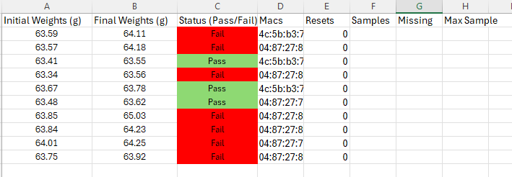
Seal Test Walkthrough

Slide 14
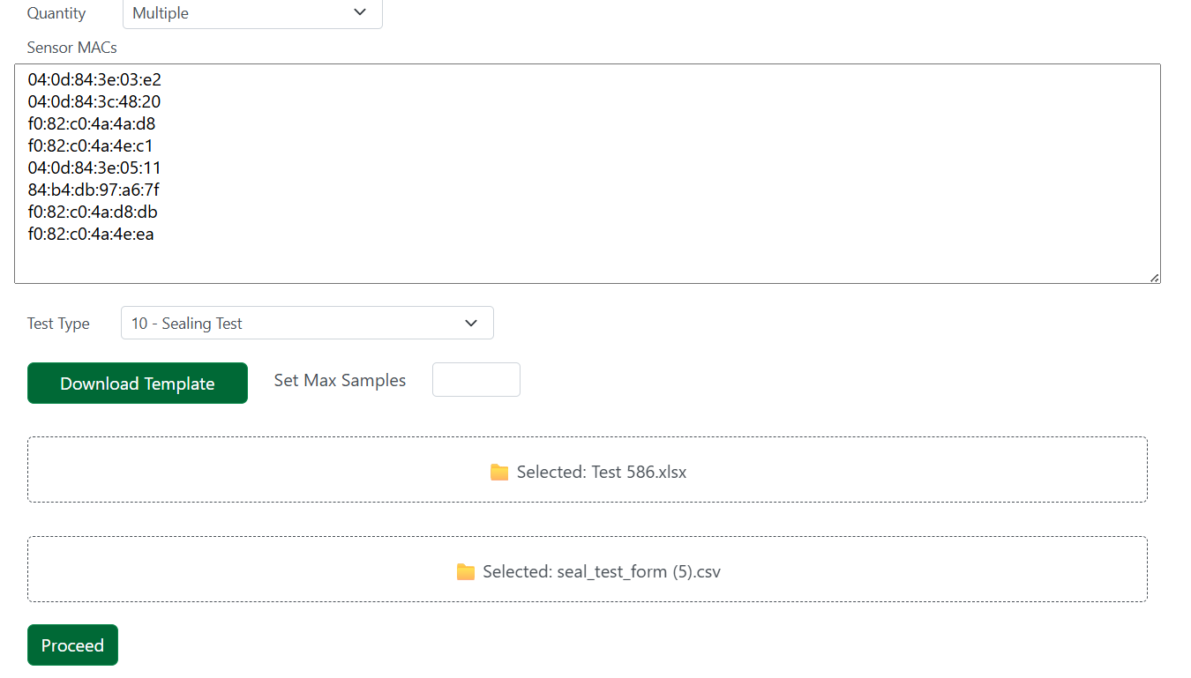
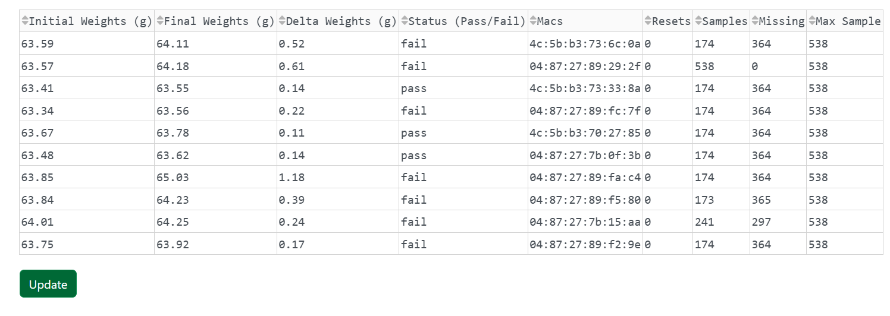
Seal Test Walkthrough

